Slide 1
Survey of Resonant Converter Topologies
Application note – TI
Literature number – SLUP376

Slide 2
Abstract
Key Characteristics
Analysis methodology
Control challenges
Design considerations
Switching frequency – ~ 1 MHz
Output voltage regulation range (2 to 1 output voltage regulation level)
New CLL resonant converter vs. Traditional LLC series resonant converter.

Slide 3
Contents
Introduction
Resonant Topology Fundamentals
Resonant Converter Structure
Fundamental Harmonic Approximation (FHA)
Fundamental Resonant Elements
2- and 3- Element Resonant Topologies
Soft – Switching Criteria
Inductive Input Impedance
Sufficient energy stored in the resonant tank
Sufficient dead-time
LLC Series Resonant Converter
Resonant Converters for Wide Input/Output Ranges
Resonant Converter Variations
Resonant Converter Design Challenges and the Effects of Real Life Parasitics and Parameters
Operational States
Transient Response
Component Parasitics
Summary

Slide 4
Introduction

Slide 5
Introduction
One key characteristics of resonant converter – High efficiency and high frequency operation with wide soft-switching ranges.
In addition, magnetic integration – low component count and cost
Rely on FM instead of traditional PWM – voltage gain can no longer derived from inductor volt-second balance, complex
3 fundamental resonant elements – series resonance (SR), parallel resonance (PR) and notch resonance (NR)
Circulating current – used to charge or discharge the parasitic capacitors of switches (eg. MOSFET) during the switching dead-time
LLC-SRC – A good candidate in isolated applications with narrow input and output voltage ranges (such as servers and telecom), might not be good for wide ranges (like battery chargers and LEDs)
LLC resonant converters – better performance than LLC-SRC for wide input or output voltage ranges.
Resonant converter design challenges –
i) (Operational states of resonant converter > PWM converter) – Synchronous rectifier controller design becomes challenging
ii) Transient response – addressed with 2 control strategies
a. Variable frequency control (VFC)
b. Hybrid hysteresis control (HHC)

Slide 6
Resonant Topology Fundamentals

Slide 7
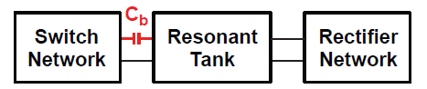
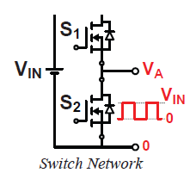
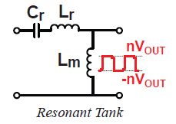
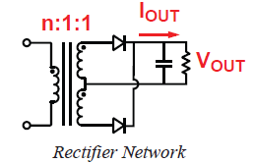
Resonant Topology Fundamentals
Resonant Converter Structure
Resonant tank – a two port network formed by L and C modulates the gain by changing the pulsating signal frequency.
DC blocking capacitor (Cb)- needed to maintain the inductor volt-second balance, i.e. to avoid saturating the transformer. ??
Half – bridge LLC-SRC

Slide 8
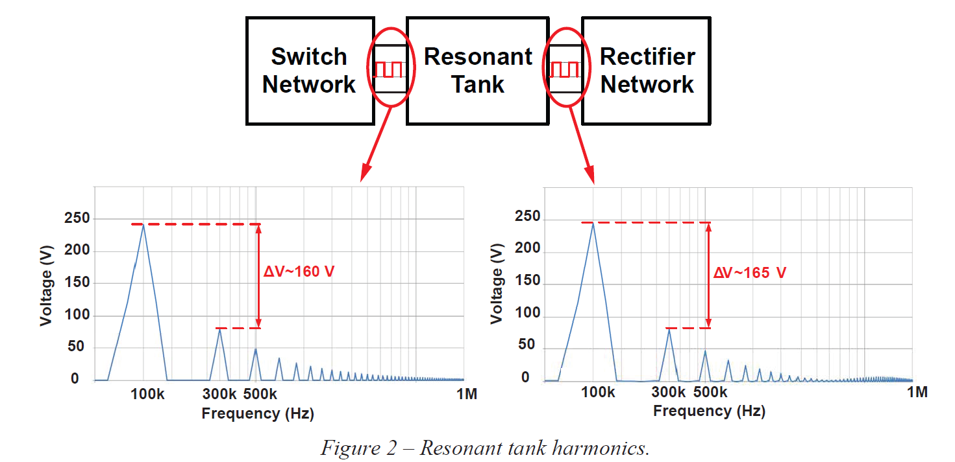
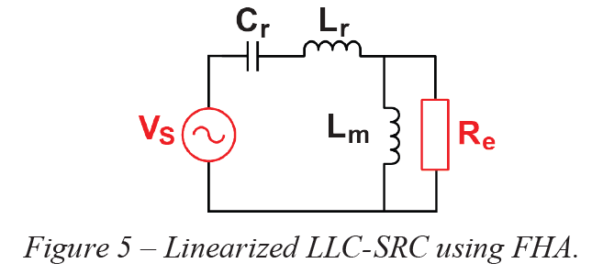
Fundamental Harmonic Approximation (FHA)
Many possible control schemes, we use FM (changing the i/p to o/p gain by only varying the switching frequency with a fixed 50% duty cycle on switch network)
Gain equation frequency dependent (complex), difficult to analyse a non-linear circuit in the time domain.
One commonly used approach – FHA (to analyse in frequency domain)
Here Vin = 390V
3rd harmonic = about 33% of fundamental
THD = about 48% of input voltage
(similarly for output voltage)
If we only consider fundamental of input
and output voltages, also assume resonant
tank output current = sinusoidal
Now we have Linear circuit. Analyse it.
Re = (8n²/π²).R

Slide 9
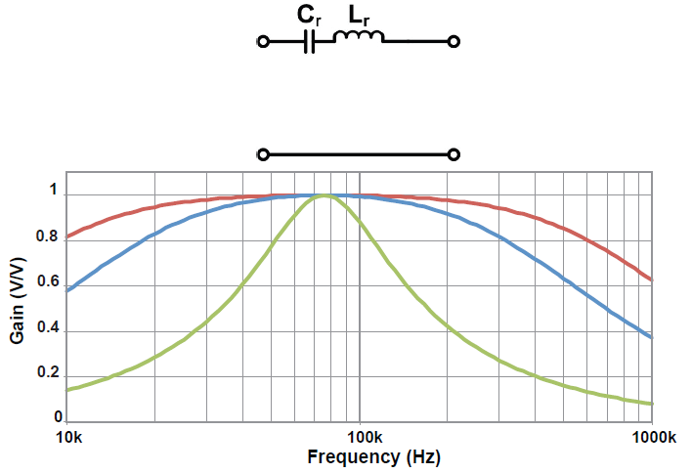
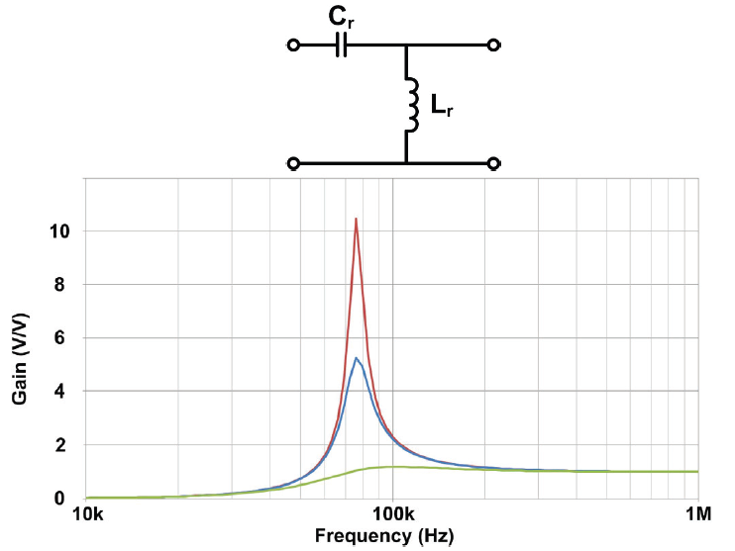
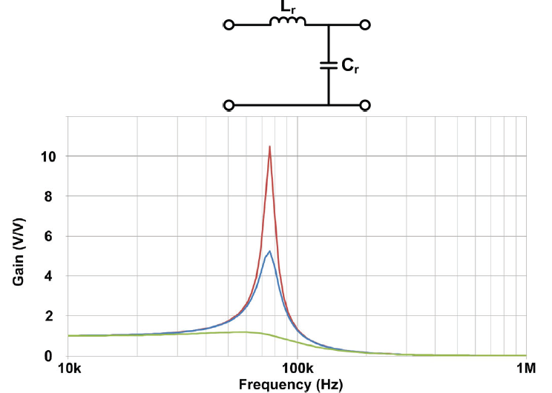
Fundamental Resonant Elements
3 fundamental resonances – Series, Parallel and Notch
Series resonance – At f = fo, Impedance = 0, Voltage gain = 1
other than wo, gain < 1 (like a Buck converter)
Parallel resonance – At f =~ fo, Voltage gain = Very high
(like a Boost converter)
Note: In case of Cr parallel with load, at high f, Xc = 0, Gain = 0.
So output SC protection.

Slide 10
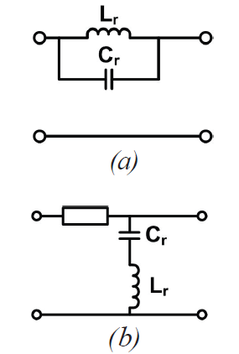
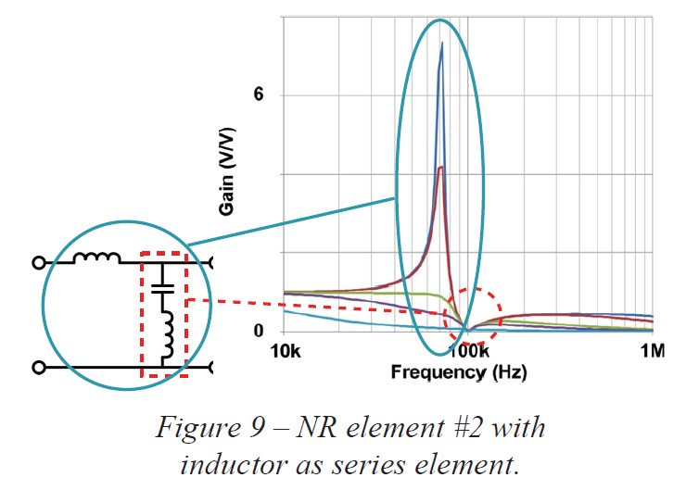
Notch resonance – either LC in parallel and placed in series with load or vice versa
1. Parallel LC in NR element: At f = fo, O.C., Gain = 0
2. Cascaded LC in NR element: At f = fo, S.C., Gain = 0
With the OC and SC characteristics, NR creates a valley in the gain curve.
The valley is undesirable – because it requires a complicated controller design.
Note: There is a series element (can be L or C), otherwise i/p and o/p will be
shorted.
Because of series element, NR will have both NR and PR characteristics
at the same time.

Slide 11
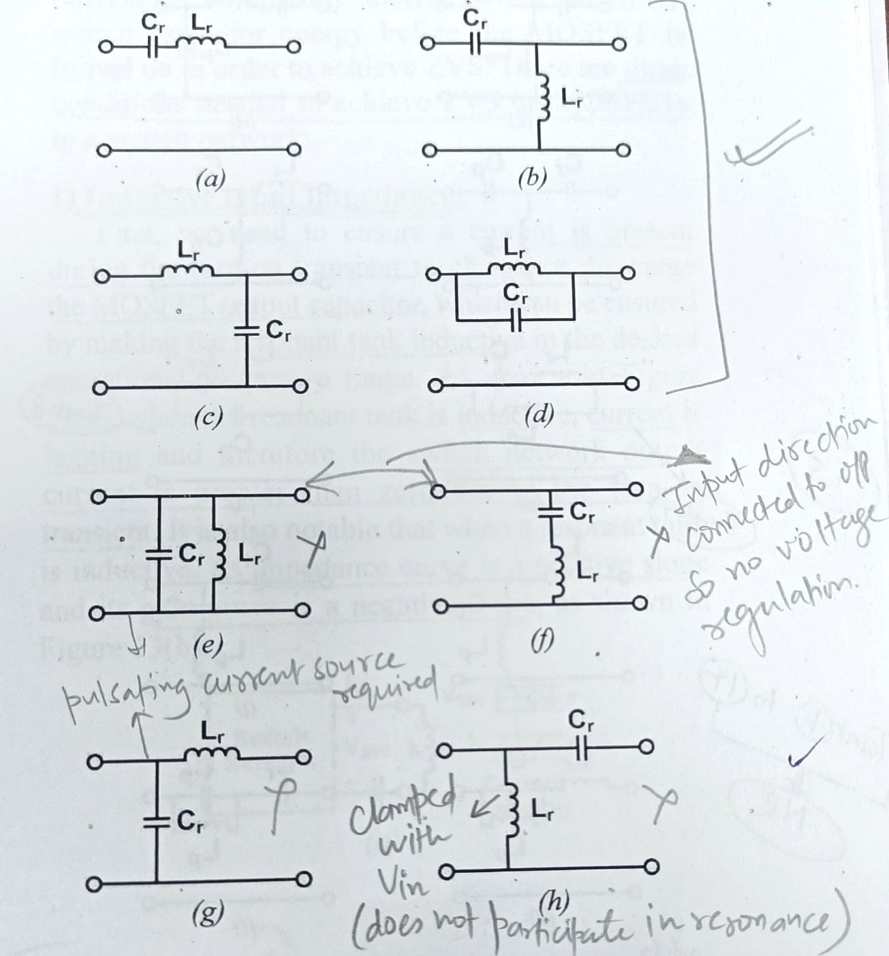
2- and 3- Element Resonant Topologies
With 2-elements: 8 possible resonant tank combinations – Only 4 tanks a,b,c,d are good.

Slide 12
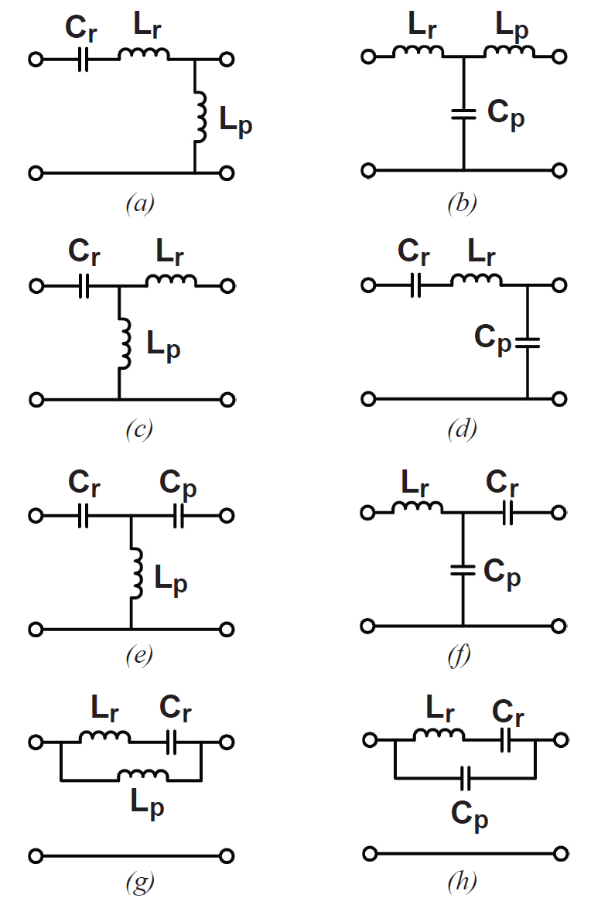
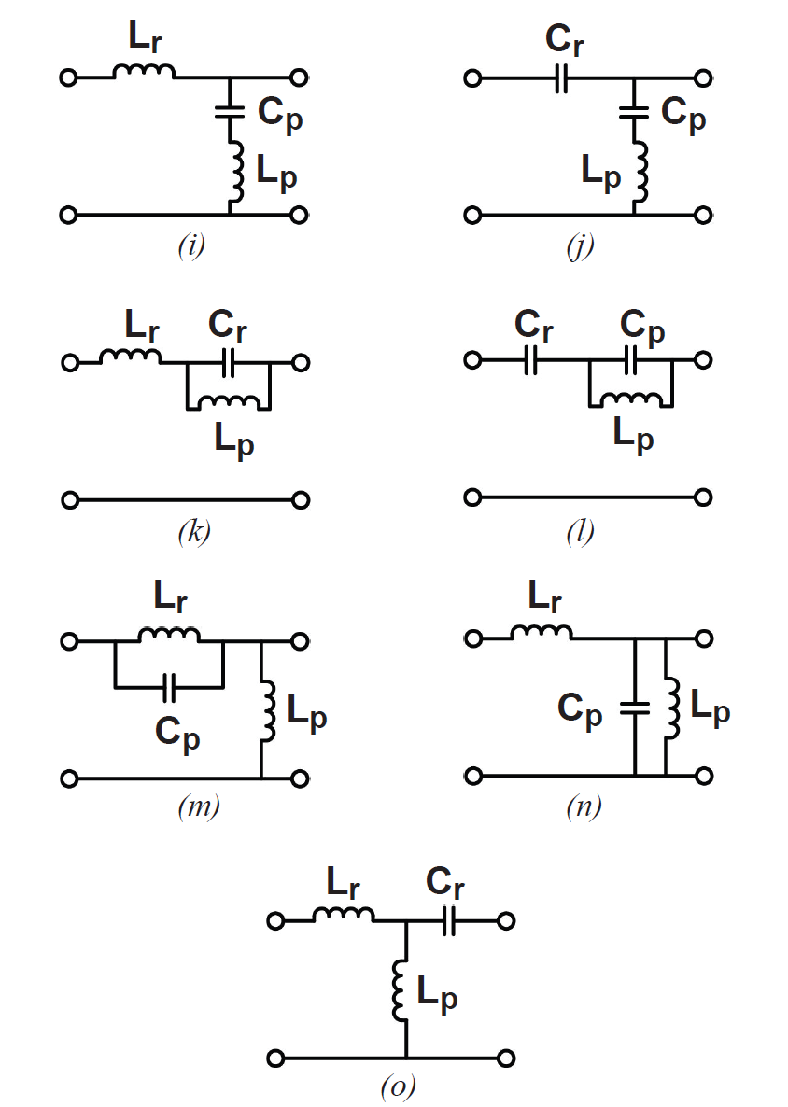
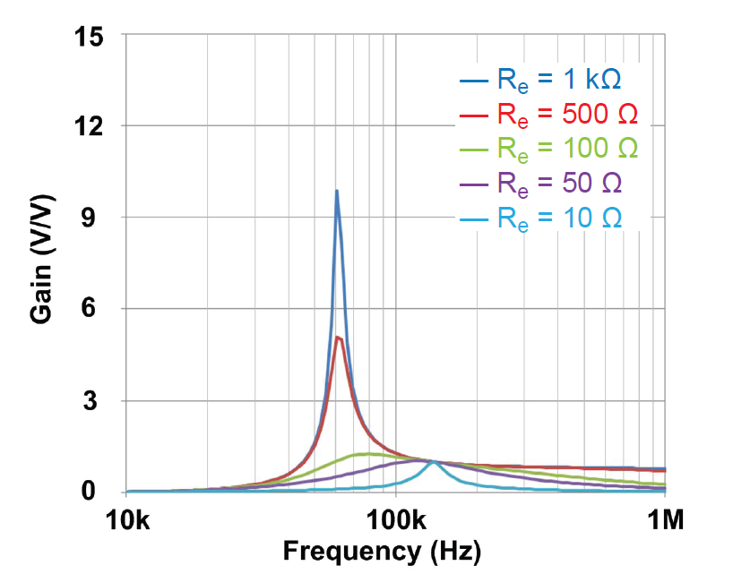
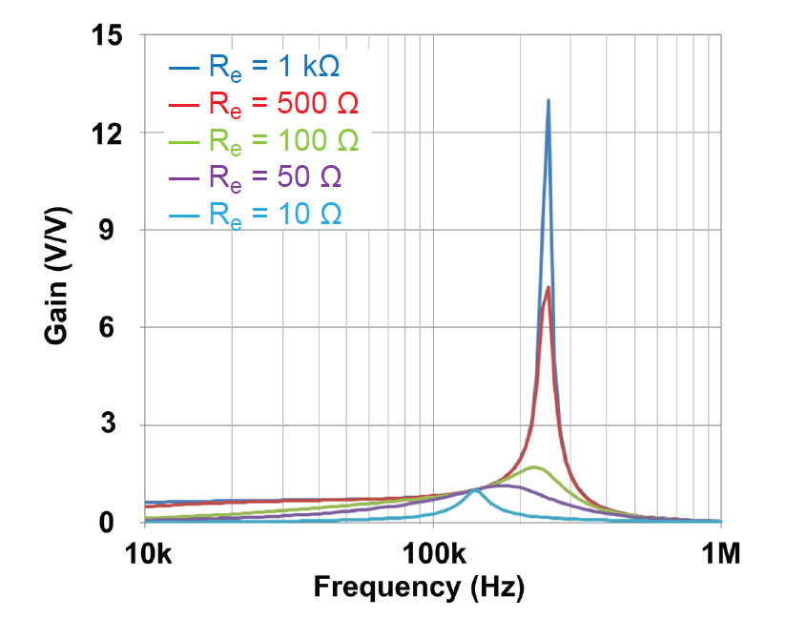
With 3-elements: 36 possible resonant tank combinations – Only 23 work with pulsating voltage
sources. Out of 23, only 15 tanks have all the resonant elements participating in resonance.
Tank ‘a’ – LLC-SRC
Tank ‘d’ – LCC
Tank ‘g’ to ‘n’ – NR
Voltage gain peak of LCC is greater
than LCC.
LLC LCC

Slide 13
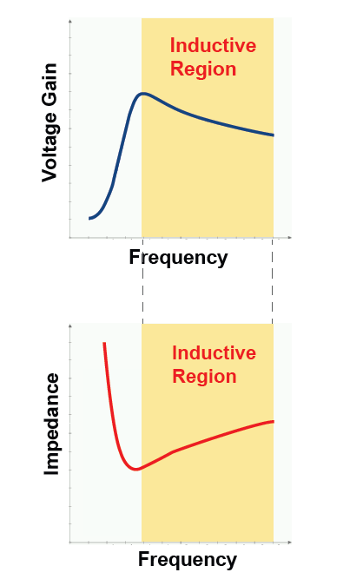
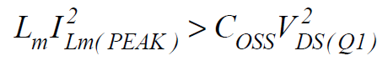
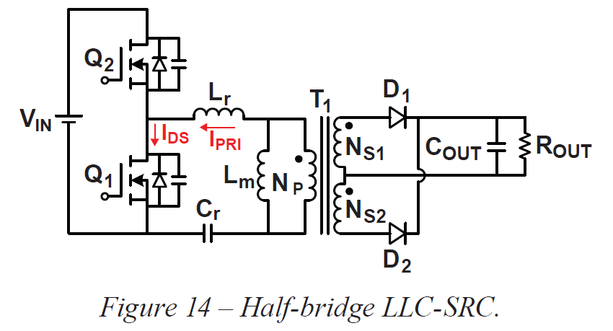
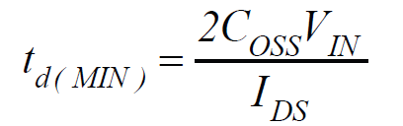
Soft-Switching Criteria
Precisely speaking, ZVS. 3 conditions to achieve ZVS –
Inductive input impedance: Its voltage gain curve is a negative slope and Impedance curve is a positive slope.
Sufficient energy stored in the resonant tank: Inductor impedance alone cannot guarantee “zero” voltage switching. Also ensure
(Energy stored)Resonant tank > (Energy stored)MOSFET output capacitors
where Coss is output capacitance of MOSFETs Q1 and Q2 and assumed constant here.
Sufficient dead-time: If a constant current IDS – used to
discharge Q1 Coss from Vin to 0 and charges Q2 Coss from 0 to Vin,
then the min time required to achieve ZVS is given by

Slide 14
LLC Series Resonant Converter

Slide 15
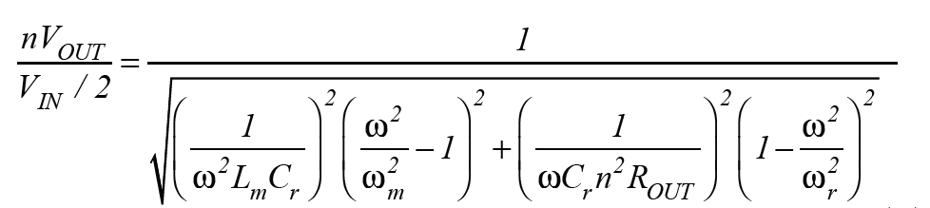
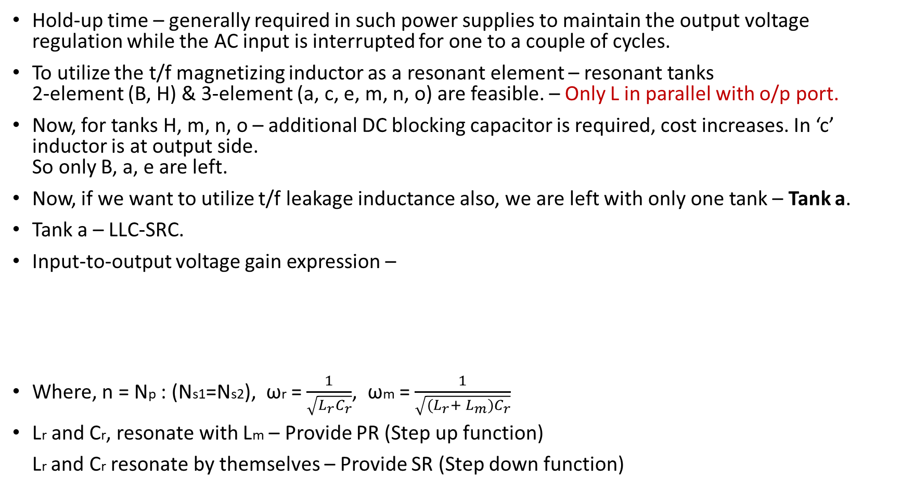
LLC Series Resonant Converter
Hold-up time – generally required in such power supplies to maintain the output voltage regulation while the AC input is interrupted for one to a couple of cycles.
To utilize the t/f magnetizing inductor as a resonant element – resonant tanks 2-element (B, H) & 3-element (a, c, e, m, n, o) are feasible. – Only L in parallel with o/p port.
Now, for tanks H, m, n, o – additional DC blocking capacitor is required, cost increases. In ‘c’ inductor is at output side. So only B, a, e are left.
Now, if we want to utilize t/f leakage inductance also, we are left with only one tank – Tank a.
Tank a – LLC-SRC.
Input-to-output voltage gain expression –
Where, n = Np : (Ns1=Ns2), ωr = $\frac{1}{\sqrt{L_{r}C_{r}}}$, ωm = $\frac{1}{\sqrt{(L_{r}+ L_{m})C_{r}}}$
Lr and Cr, resonate with Lm – Provide PR (Step up function)
Lr and Cr resonate by themselves – Provide SR (Step down function)

Slide 16
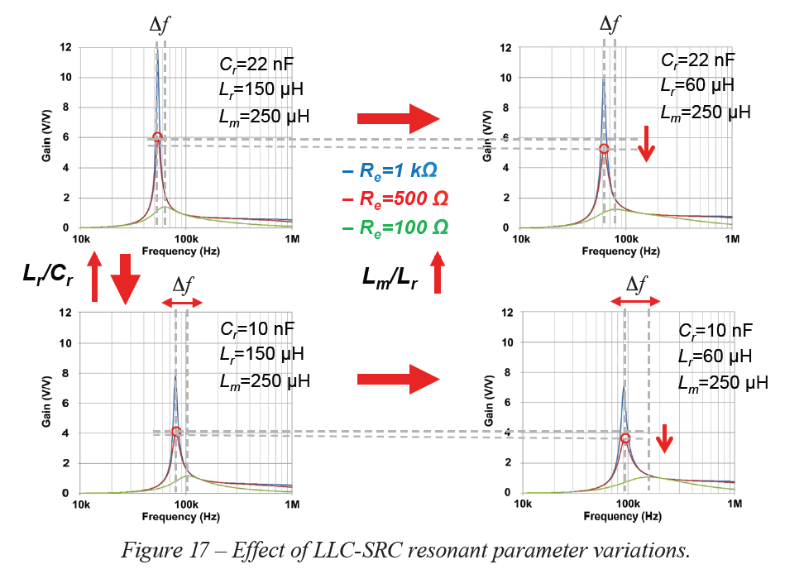
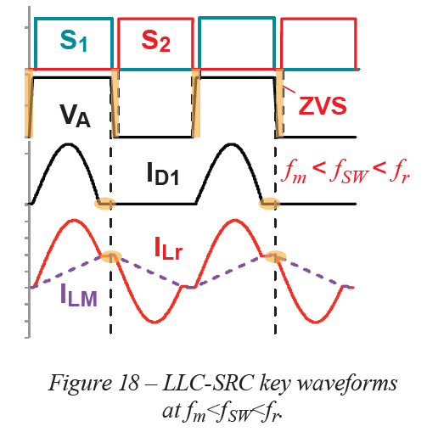
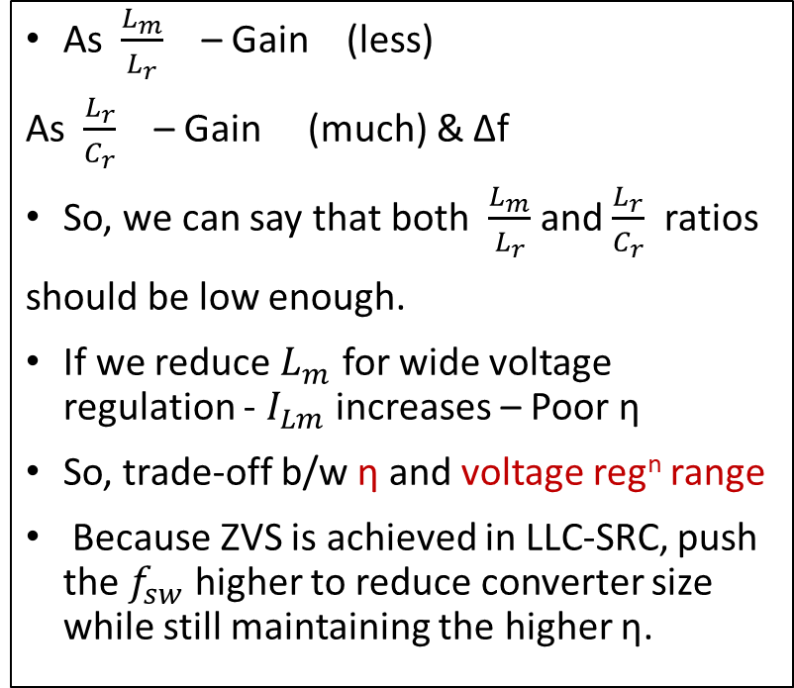
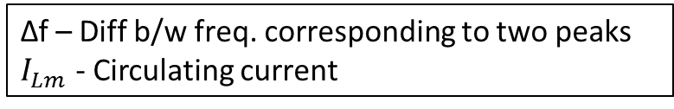
As $\frac{L_{m}}{L_{r}}$ – Gain (less)
As $\frac{L_{r}}{C_{r}}$ – Gain (much) & ∆f
So, we can say that both $\frac{L_{m}}{L_{r}}$ and $\frac{L_{r}}{C_{r}}$ ratios
should be low enough.
If we reduce $L_{m}$ for wide voltage regulation - $I_{Lm}$ increases – Poor η
So, trade-off b/w η and voltage reg^{n} range
Because ZVS is achieved in LLC-SRC, push the $f_{sw}$ higher to reduce converter size while still maintaining the higher η.
A 385V input to 48V/1 kW output, 1MHz with GaN FETs is realized in the paper.
Power stage vol = 6 in³, power density = 167 W/m³
97.6% peak efficiency is achieved.
∆f – Diff b/w freq. corresponding to two peaks
$I_{Lm}$ - Circulating current
Notes:
Food for thought – Why can’t we increase Lr to keep (Lm/Lr) low ??

Slide 17
Resonant Converters for Wide I/O voltage ranges

Slide 18
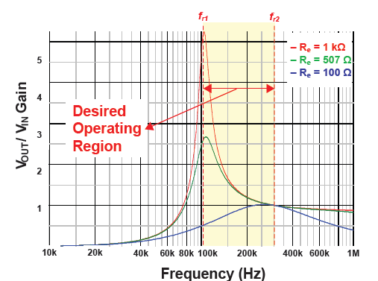
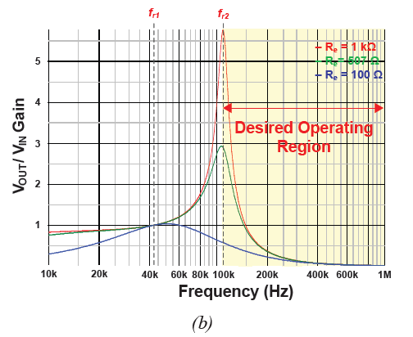
Resonant Converters for Wide I/O voltage ranges
For high voltage gain – we need tanks with PR – 2 elements (B, C), 3 elements (a, b, c, d, e, f and m)
m – ruled out because its NR can lead to difficult control design.
Now, tanks (a, b, c) – 2L1C and tanks (d, e, f) – 1L2C
Let’s take tank a (LLC) tank d (LCC)
2 conditions to be met – (i) wide voltage range and narrow frequency range, (ii) inductive i/p impedance for soft switching
Between two resonant freq. in tank a
Above higher resonant freq. in tank d
Tank a (LLC)
Tank d (LCC)

Slide 19
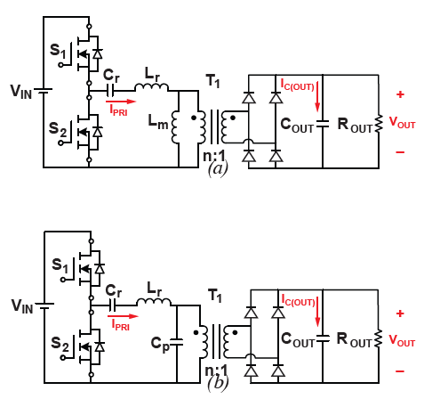
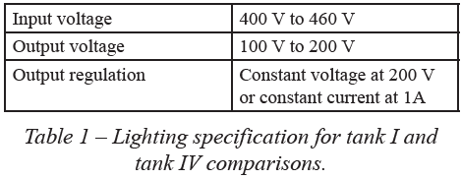
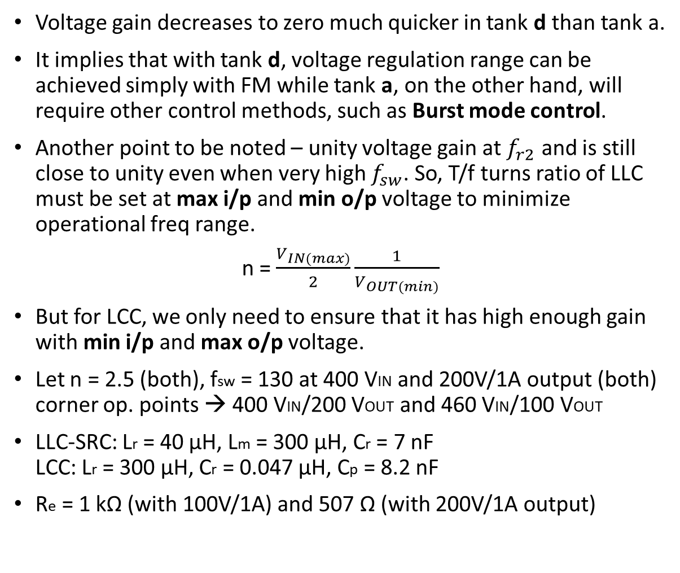
Voltage gain decreases to zero much quicker in tank d than tank a.
It implies that with tank d, voltage regulation range can be achieved simply with FM while tank a, on the other hand, will require other control methods, such as Burst mode control.
Another point to be noted – unity voltage gain at $f_{r2}$ and is still close to unity even when very high $f_{sw}$. So, T/f turns ratio of LLC must be set at max i/p and min o/p voltage to minimize operational freq range.
n = $\frac{V_{IN(max)}}{2}\frac{1}{V_{OUT(min)}}$
But for LCC, we only need to ensure that it has high enough gain with min i/p and max o/p voltage.
Let n = 2.5 (both), fsw = 130 at 400 VIN and 200V/1A output (both) corner op. points → 400 VIN/200 VOUT and 460 VIN/100 VOUT
LLC-SRC: Lr = 40 µH, Lm = 300 µH, Cr = 7 nF LCC: Lr = 300 µH, Cr = 0.047 µH, Cp = 8.2 nF
Re = 1 kΩ (with 100V/1A) and 507 Ω (with 200V/1A output)

Slide 20
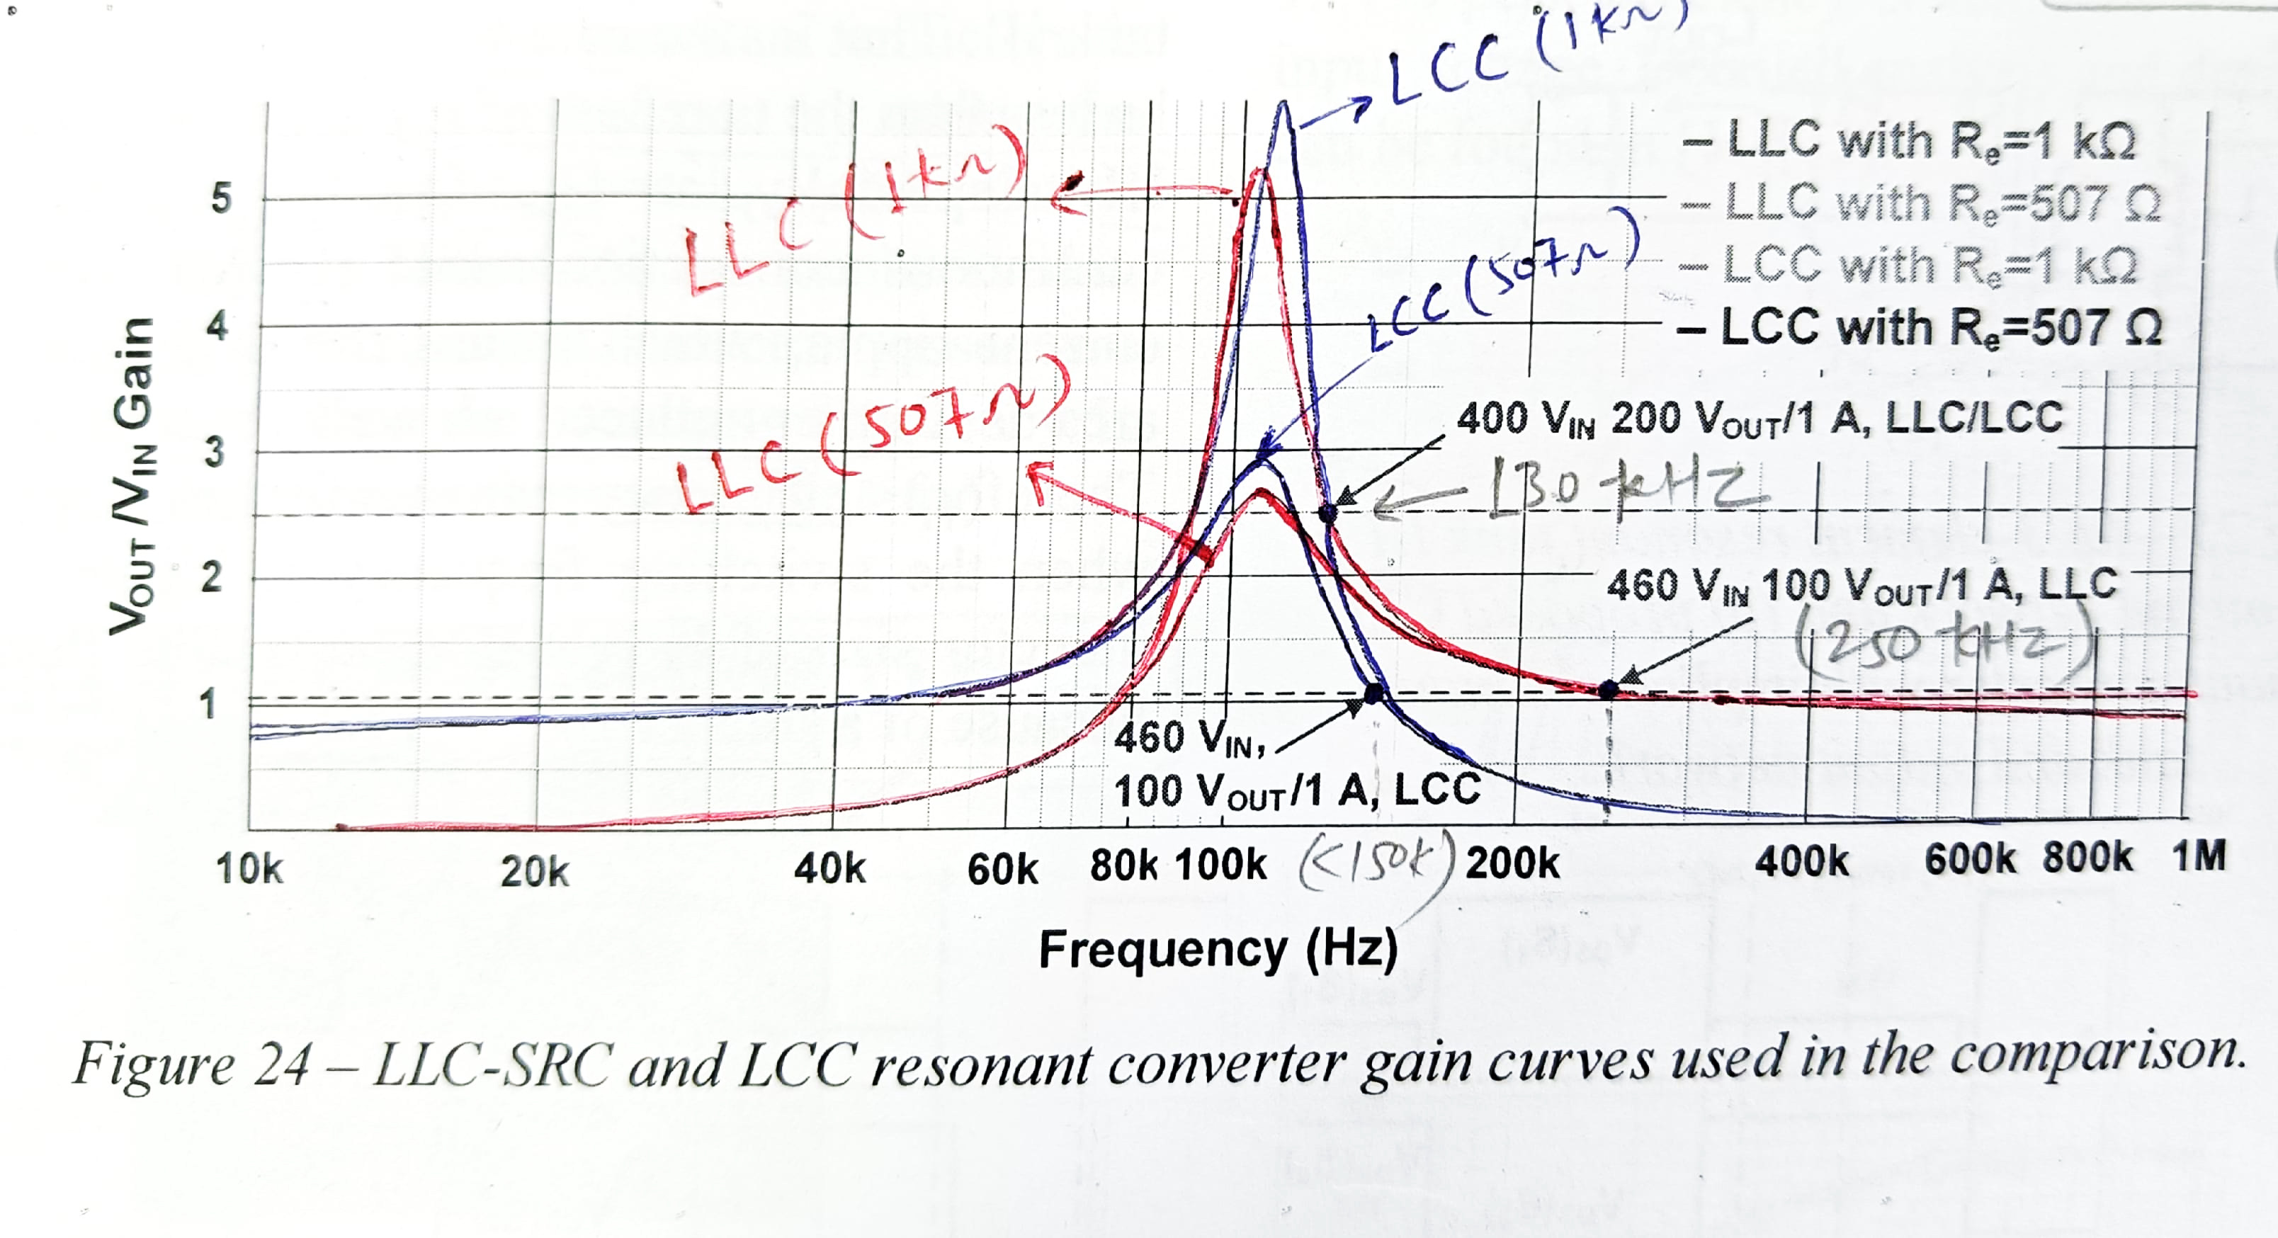
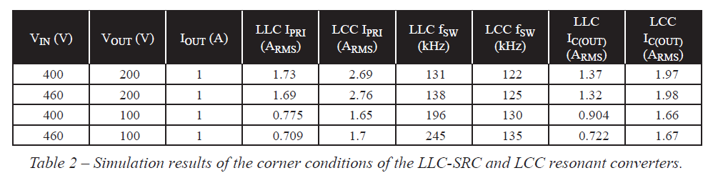
For 460 VIN LLC-SRC: op point 250 kHz LCC: op point below 150 kHz
So, if regulation is wider than specs in table 1 : LLC-SRC – No longer feasible (go for LCC)
But in LCC, higher RMS current (IPRI) – more losses, lower converter η
Conclusion:
For better η : LLC-SRC
For wider voltage regulation : LCC
So, a trade-off must be made.

Slide 21
Resonant Converters Variations

Slide 22
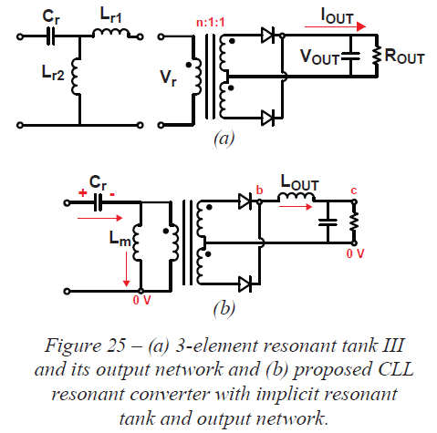
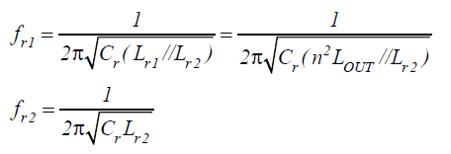
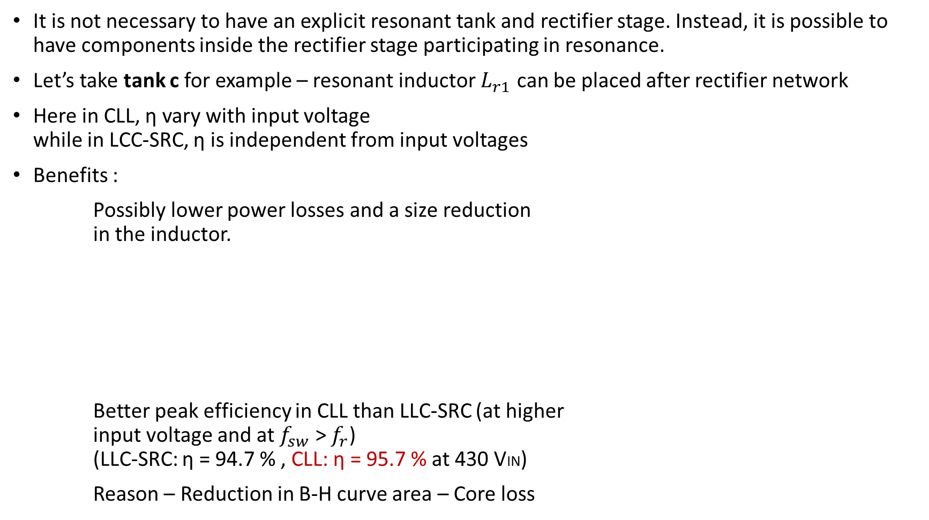
Resonant Converters Variations
It is not necessary to have an explicit resonant tank and rectifier stage. Instead, it is possible to have components inside the rectifier stage participating in resonance.
Let’s take tank c for example – resonant inductor $L_{r1}$ can be placed after rectifier network
Here in CLL, η vary with input voltage while in LCC-SRC, η is independent from input voltages
Benefits :
Possibly lower power losses and a size reduction in the inductor.
Better peak efficiency in CLL than LLC-SRC (at higher input voltage and at $f_{sw}$ > $f_{r}$) (LLC-SRC: η = 94.7 % , CLL: η = 95.7 % at 430 VIN)
Reason – Reduction in B-H curve area – Core loss

Slide 23
Resonant Converter Design
Challenges and the Effects of
Real Life Parasitics and
Parameters

Slide 24
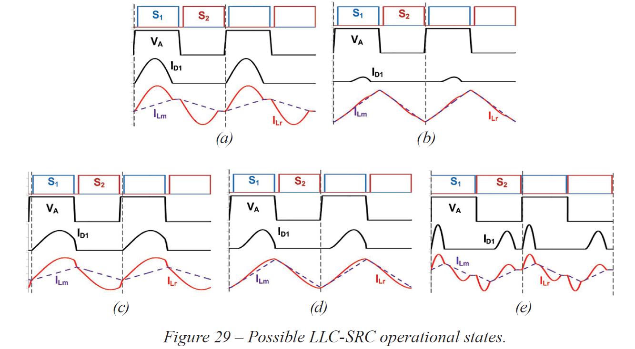
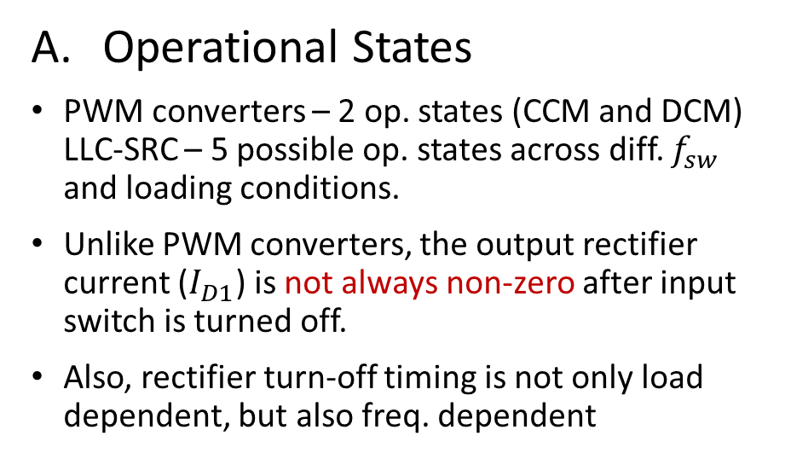
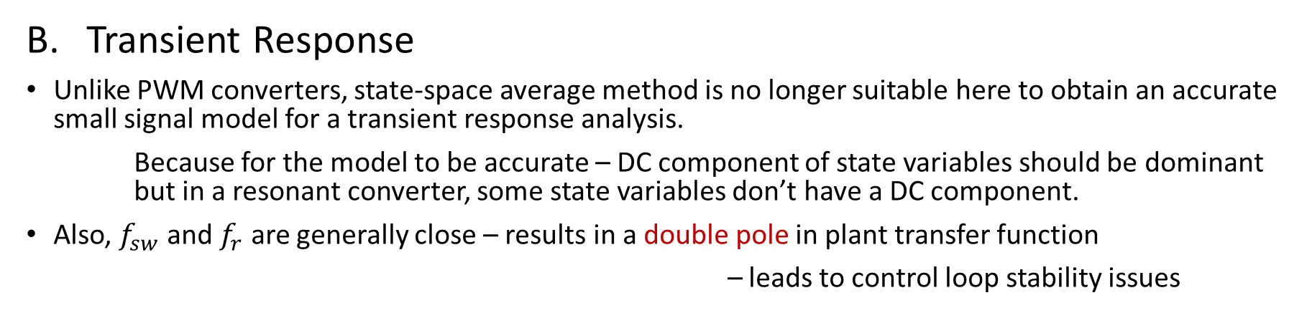
Design challenges and effect of Parasitics
Operational States
PWM converters – 2 op. states (CCM and DCM) LLC-SRC – 5 possible op. states across diff. $f_{sw}$ and loading conditions.
Unlike PWM converters, the output rectifier current ($I_{D1}$) is not always non-zero after input switch is turned off.
Also, rectifier turn-off timing is not only load dependent, but also freq. dependent
Transient Response
Unlike PWM converters, state-space average method is no longer suitable here to obtain an accurate small signal model for a transient response analysis.
Because for the model to be accurate – DC component of state variables should be dominant but in a resonant converter, some state variables don’t have a DC component.
Also, $f_{sw}$ and $f_{r}$ are generally close – results in a double pole in plant transfer function
– leads to control loop stability issues

Slide 25
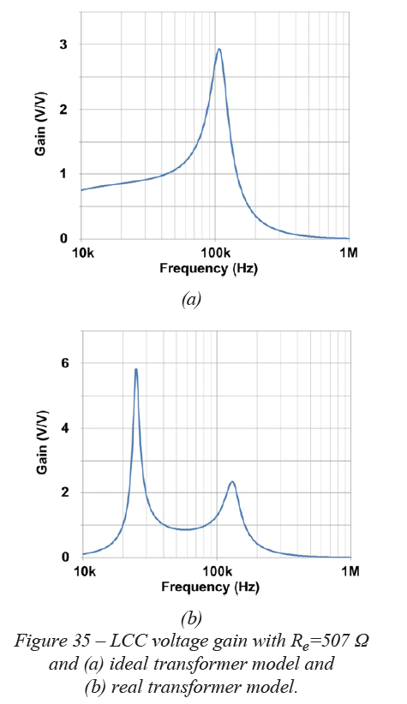
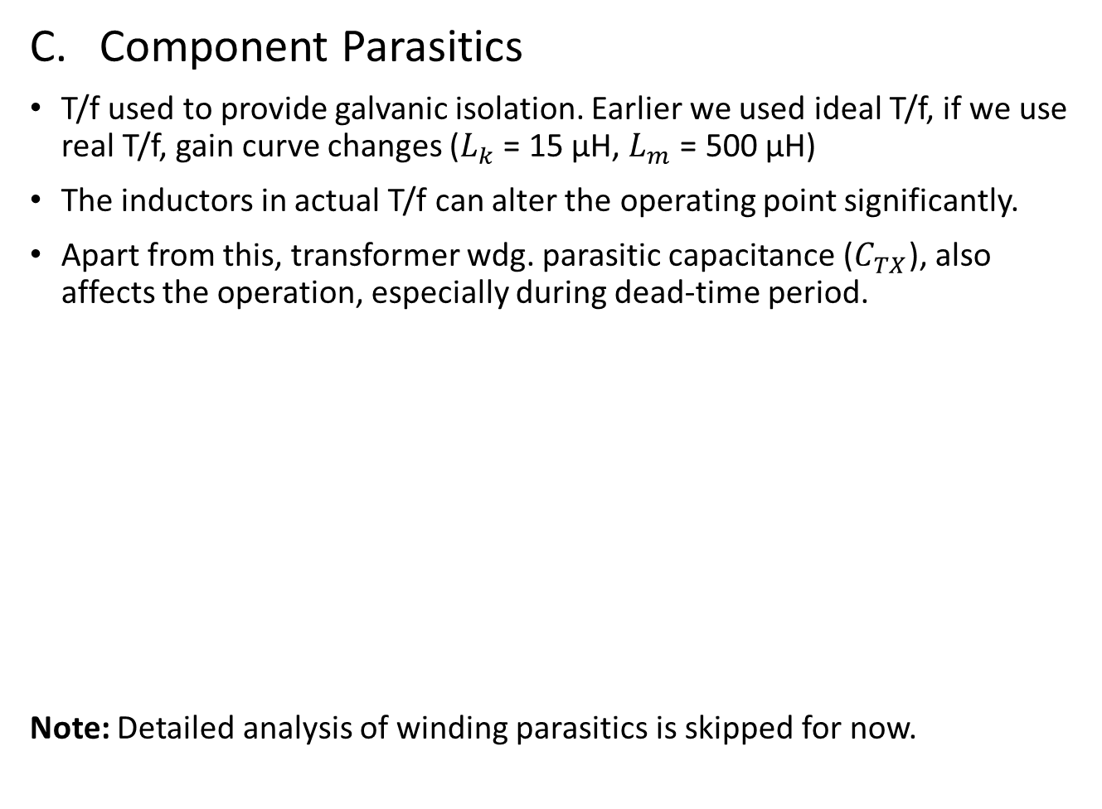
Component Parasitics
T/f used to provide galvanic isolation. Earlier we used ideal T/f, if we use real T/f, gain curve changes ($L_{k}$ = 15 µH, $L_{m}$ = 500 µH)
The inductors in actual T/f can alter the operating point significantly.
Apart from this, transformer wdg. parasitic capacitance ($C_{TX}$), also affects the operation, especially during dead-time period.
Note: Detailed analysis of winding parasitics is skipped for now.

Slide 26
Summary

Slide 27
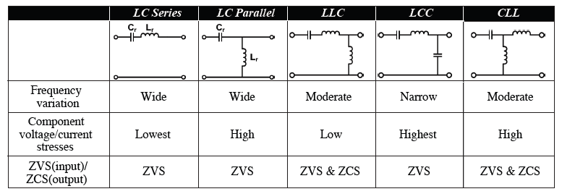
Summary
SR, PR, NR – Studied (PR can be found in almost every isolated resonant converter)
Voltage gain peak increases as no. of resonant capacitors involved in PR increase
NR – avoided because it limits the freq. range of an inductive impedance resonant tank.
LLC-SRC – High efficiency and high density, while LCC – Higher voltage gain variation with less η
Large circulating current in LCC than LLC-SRC.
Implicit resonant tank (CLL) : advantageous in size and efficiency.
In addition to ZVS, both LLC-SRC and CLL can achieve ZCS on the rectifier network.
Comparison table -

Slide 28
Thank You

